Slide 1

Gulf Countries Oil Market Analysis
Pravir Mishra ( E22BCAU0143 )
Harsh Chaudhary ( E22BCAU0029 )
Nakul Chauhan ( E22BCAU0013 )

Slide 2

Objective of this project.
Objective
Understanding the current market
Import and export analysis
Revenue utilization
OIL taxes
Future projection, demand and supply
Historical trends
Decreasing oil extraction

Slide 3
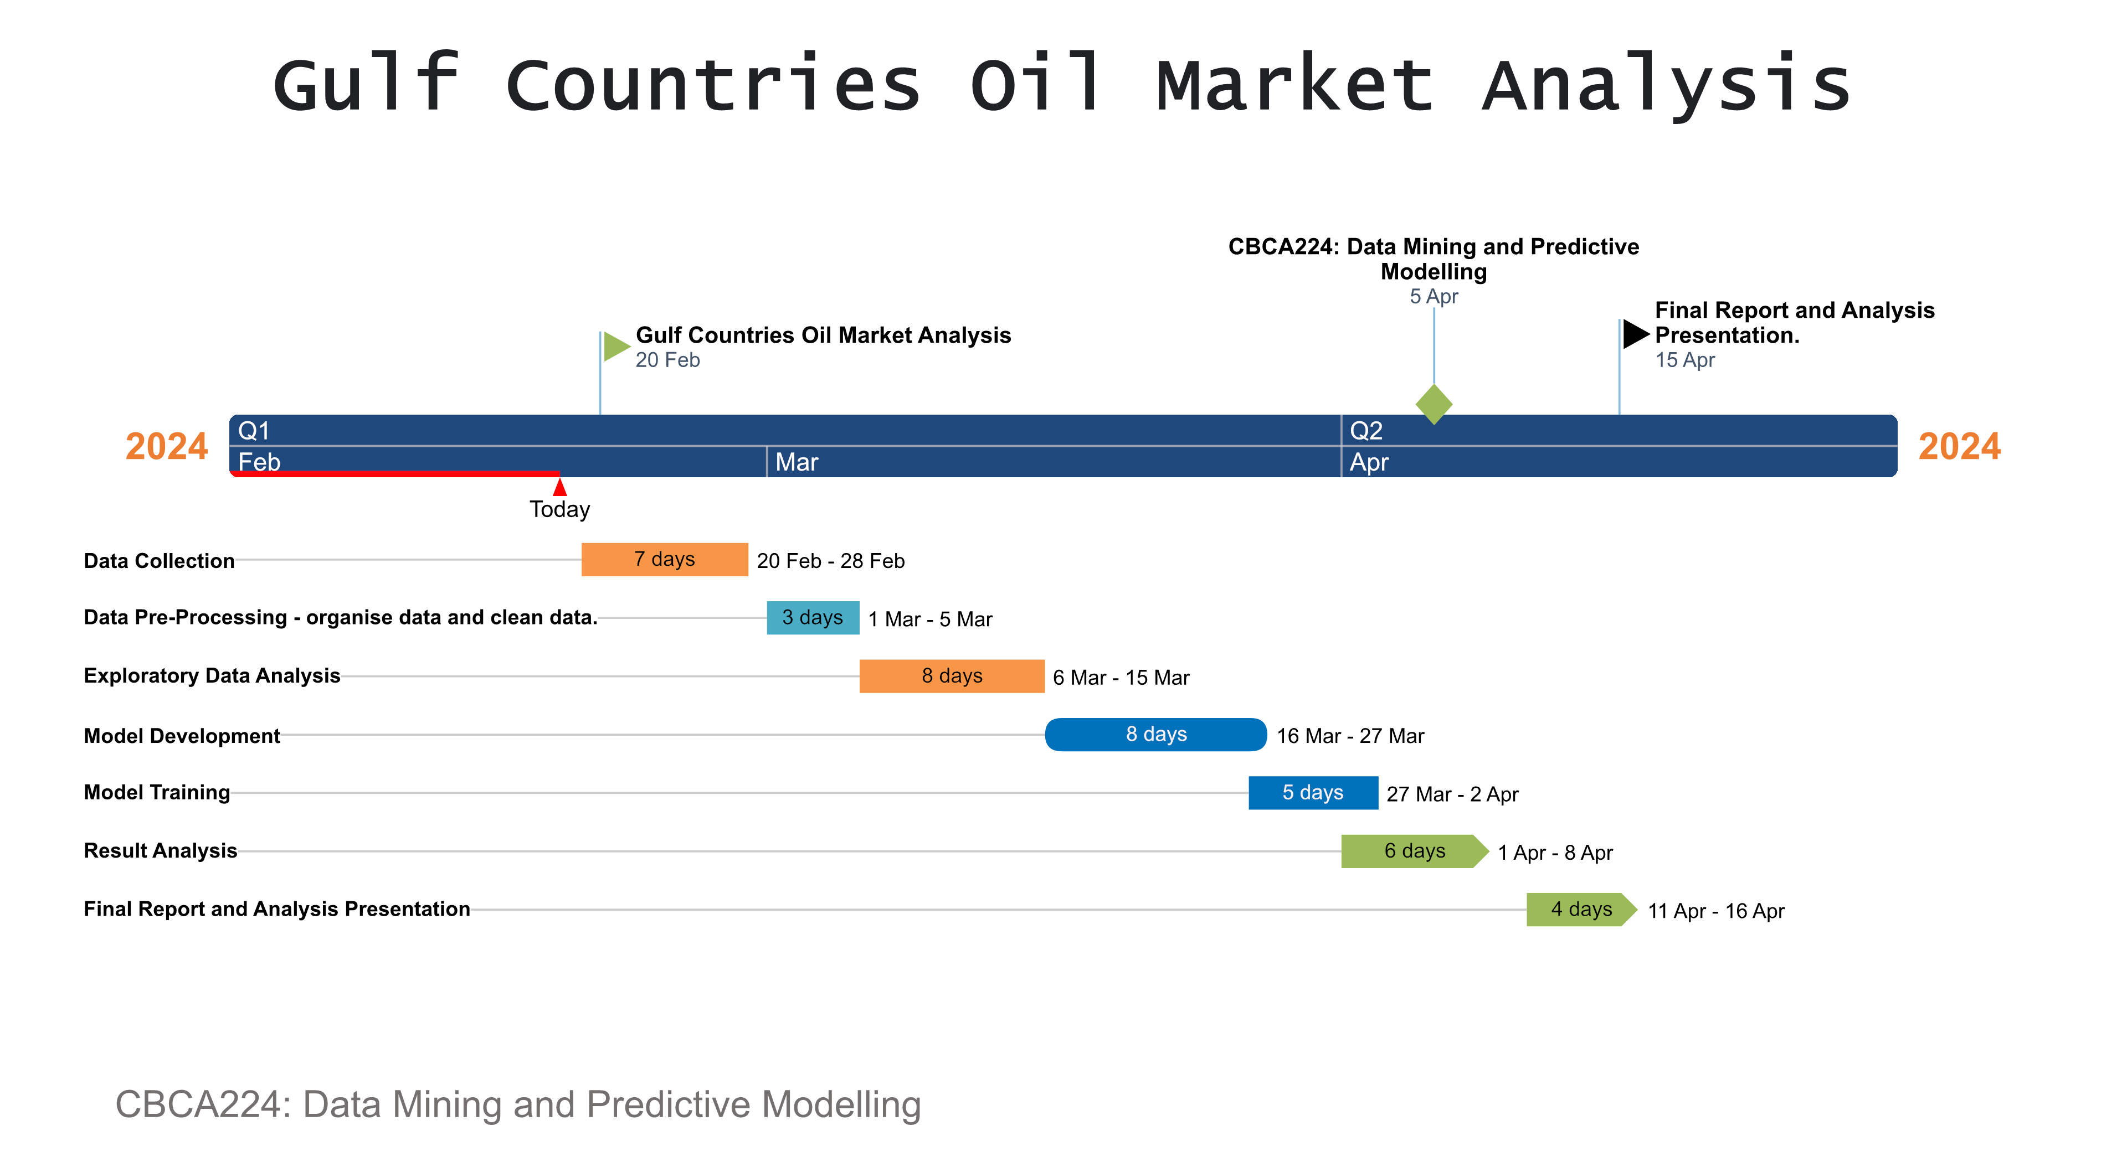
Gantt Chart

Slide 4

Software and Hardware Requirement
Software:
Data Collection and Cleaning:
Excel or Python for data manipulation and cleaning.
Quantitative Analysis:
Python for statistical analysis and modelling.
Visualization:
Python for data visualization (e.g.,ggplot2, Matplotlib).
Hardware:
Cloud computing.
External hard drives or cloud storage.
Online resources and collaboration.

Slide 5
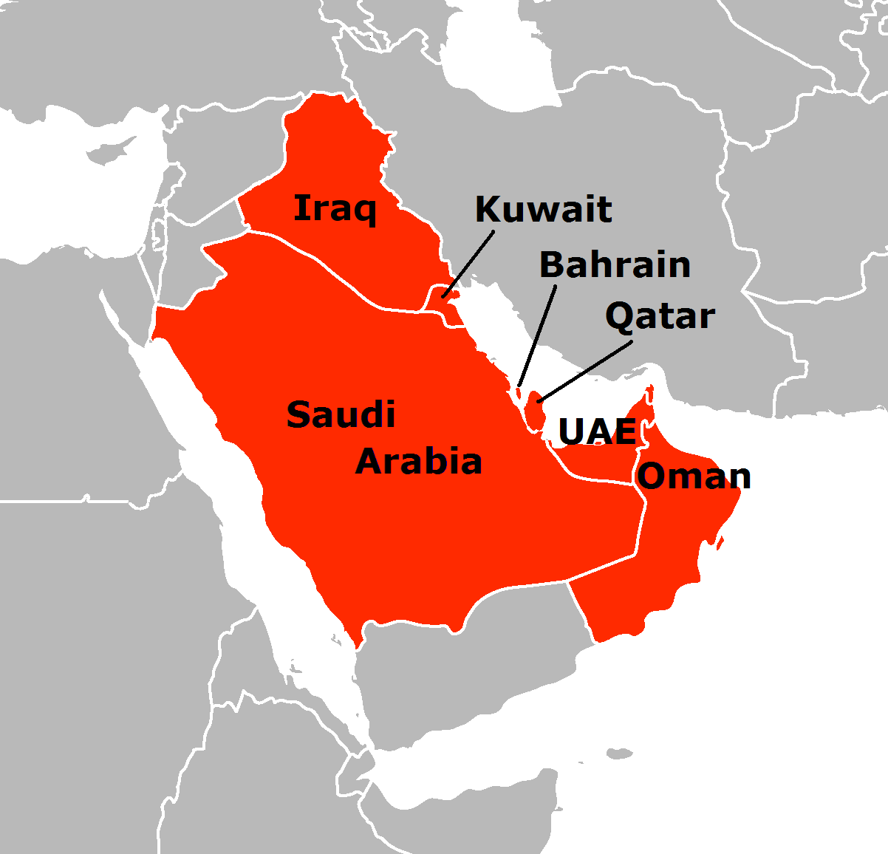
Gulf countries
Bahrain
Kuwait
Iraq
Oman
Qatar
Saudi Arabia
The United Arab Emirates (UAE)

Slide 6

Data Collection:
Gather relevant data on
Oil production, exports
Imports
Prices
Other relevant factors
from Gulf Countries (such as Saudi Arabia, Iraq, Kuwait, UAE, etc.)
Data is being collected from a Python random csv file generator.

Slide 7

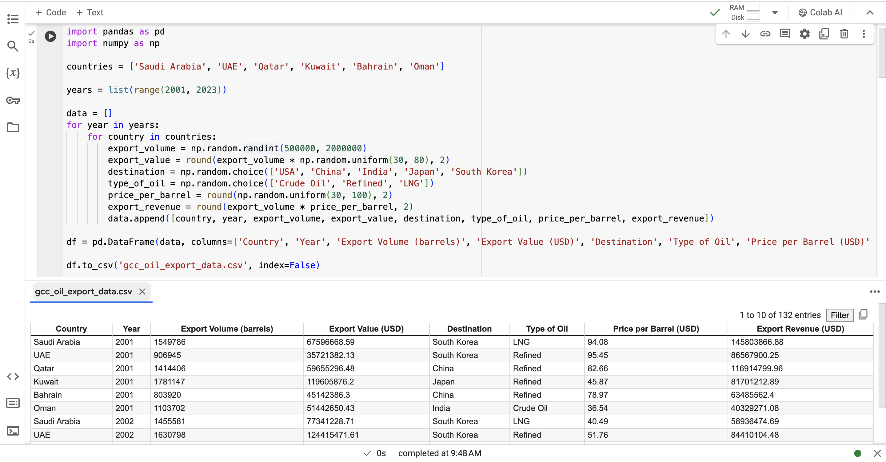
Oil Export Data Simulation for Gulf Countries (2001-2022)
COMPETITORS
Our product is priced below that of other financial management tools on the market
Simple and easy to use app and website, compared to the complex tools of the competitors
Affordability is the main draw for our consumers to our product

Slide 8
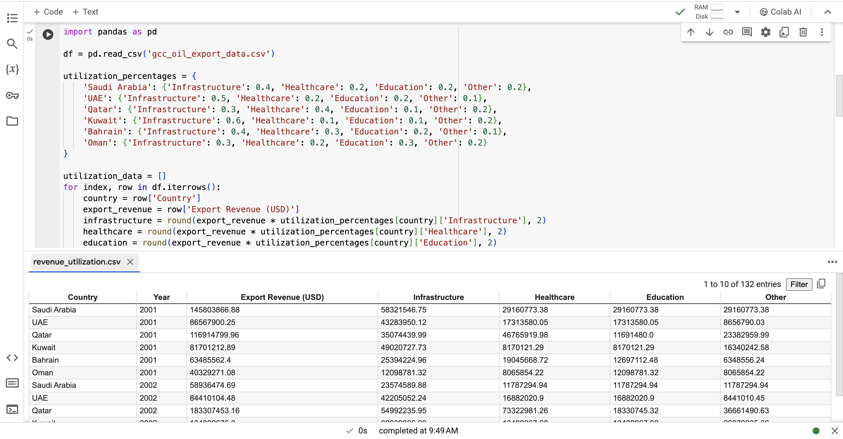
Export Revenue Utilization Breakdown for Gulf Countries

Slide 9
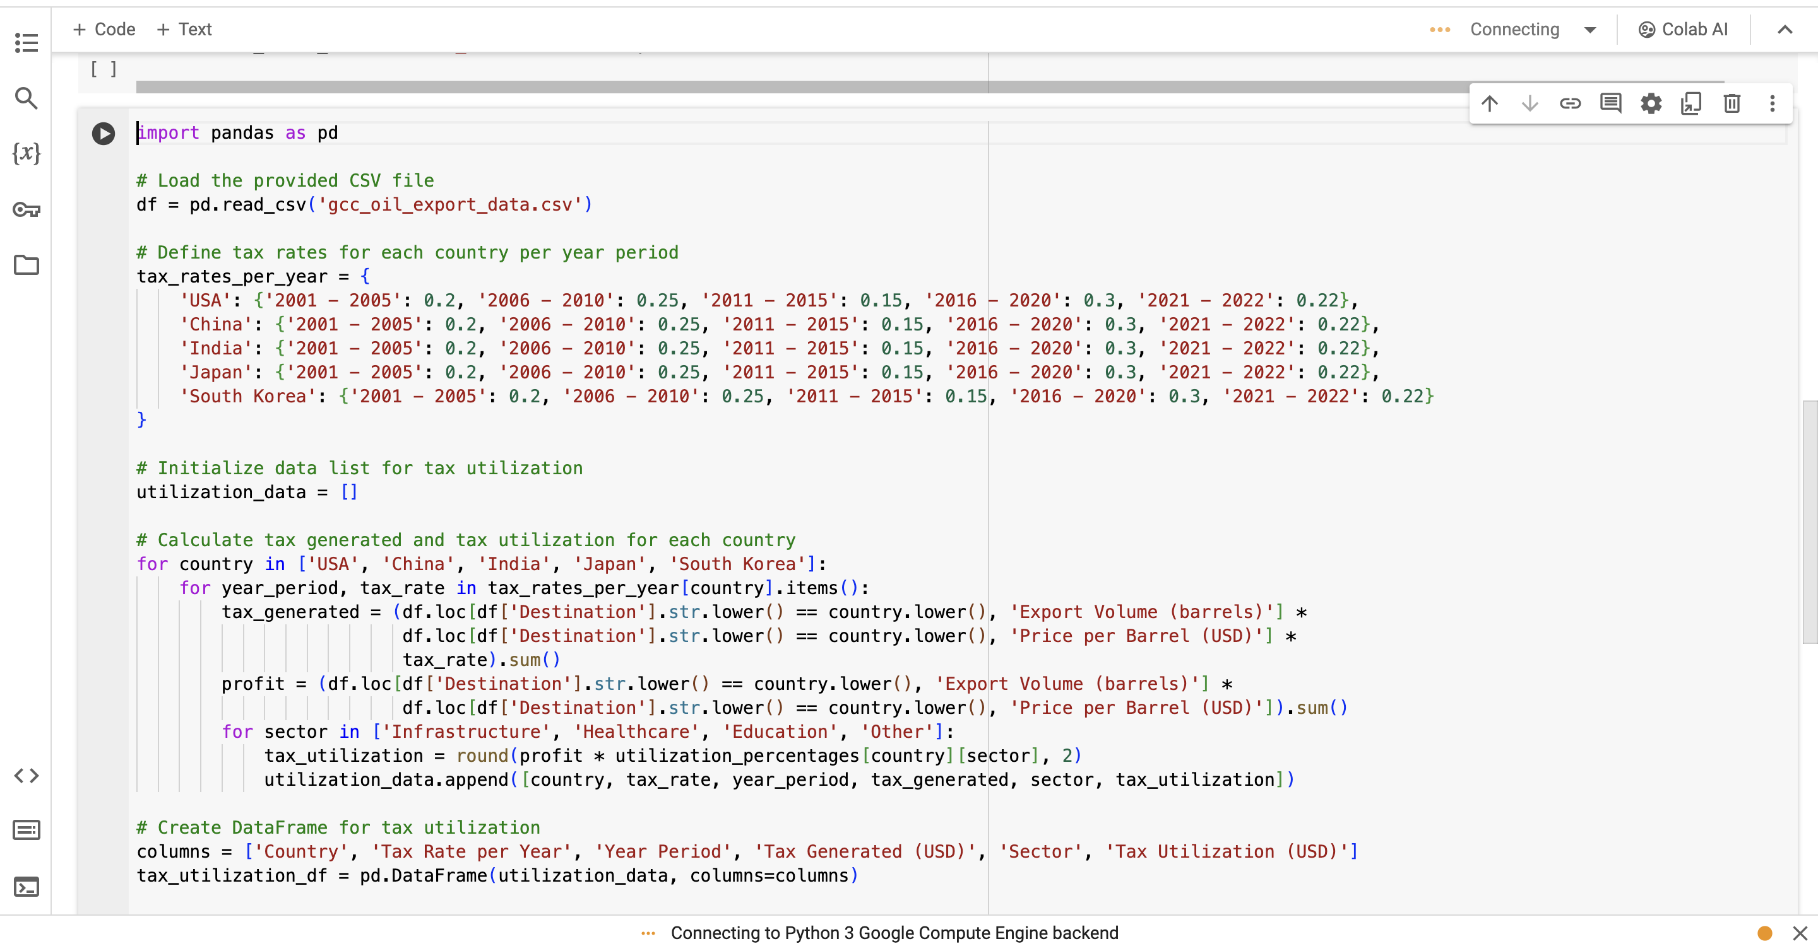
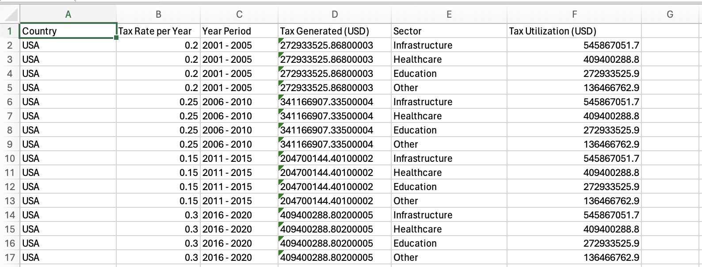
Tax Analysis of Countries' Oil Exports to Key Markets

Slide 10

Data Cleaning and Pre-processing:
Handling Missing Values:
Handling Outliers:
Data Transformation:
Imputation , replacing missing values with a suitable estimate), removing rows or columns with too many missing values, or using domain knowledge to infer missing values.
Identify outliers using statistical methods decide whether to remove them, transform them, or treat them specially in the analysis.
Convert the data into a suitable format for analysis.

Slide 11

Exploratory Data Analysis (EDA)
Seasonality and Trends:
Data Summary:
Data Visualization:
Correlation Analysis:
Generate descriptive statistics (mean, median, min, max, etc.) for numerical variables and frequency tables for categorical variables.
Use visualizations like histograms, box plots, and scatter plots to explore the distribution of data, identify patterns.
Calculate correlation coefficients between variables to identify relationships.
you could analyze the correlation between oil prices and production levels
Explore seasonal patterns and trends in the data using techniques like seasonal decomposition or time series analysis.

Slide 12
Feature Engineering:
Lag Features: Create lag features to capture the effect of past oil prices, production levels, or exports on current prices or quantities. This can help capture trends and seasonality in the data.
Difference Features: you could calculate the difference in oil prices between two consecutive days to capture short-term fluctuations.
Time Since Last Event: Calculate the time elapsed since the last significant event (e.g., a change in government policy, a major geopolitical event) that could impact oil prices or production levels.
Normalization and Scaling: Normalize or scale features to ensure that they are on a similar scale, which can improve the performance of certain models (e.g., neural networks).

Slide 13
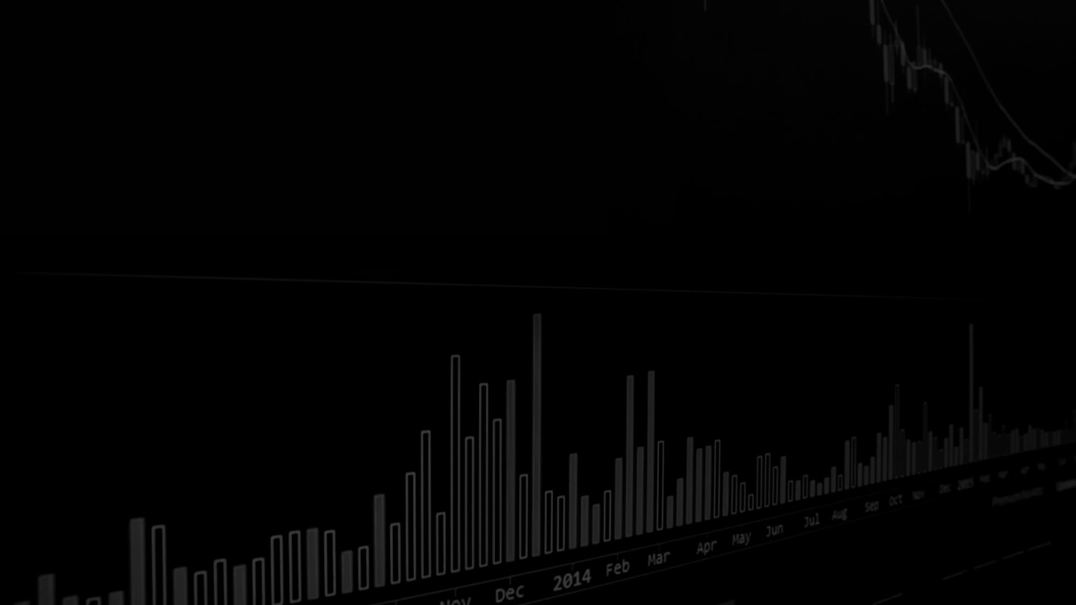
Forecasting Gulf Countries' Oil Market Trends
Objective:
Methods:
Benefits:
Predict future trends in Gulf Countries' oil production, exports, and prices.
Use historical data and advanced forecasting models.
Time series analysis using ARIMA (Autoregressive Integrated Moving Average) models.
Machine learning models like LSTM (Long Short-Term Memory) for price forecasting.
Statistical methods to analyse and forecast supply and demand dynamics.
Anticipate market trends for strategic decision-making.
Optimize production, export, and pricing strategies.
Improve risk management and profitability.

Slide 14

Model Training and Evaluation
Model Selection:
Model Training:
Model Evaluation:
Exploring various machine learning models like linear regression, decision trees, and random forests.
Selecting models based on performance metrics such as RMSE (Root Mean Squared Error) and MAE (Mean Absolute Error).
Splitting the dataset into training and testing sets.
Training the selected models on the training set.
Evaluating model performance using the testing set.
Comparing performance metrics to choose the best model.

Slide 15

Future work
I am currently working on developing a website to showcase my analysis of the Gulf Countries' oil market.
This website will feature insights into oil production, exports, imports, prices, and other relevant factors affecting the region's oil industry.
GCC Oil

Slide 16

Thank You

